Slide 1
FOXSI-2 flight summary
2014-Dec-22

Slide 2
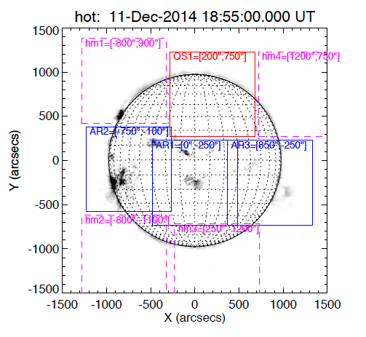
Pointing plan
Sequence (20-100 sec on each):
AR1
AR2
AR3
QS1
QS1 (shutter in)
AR1 (shutter in)

Slide 3
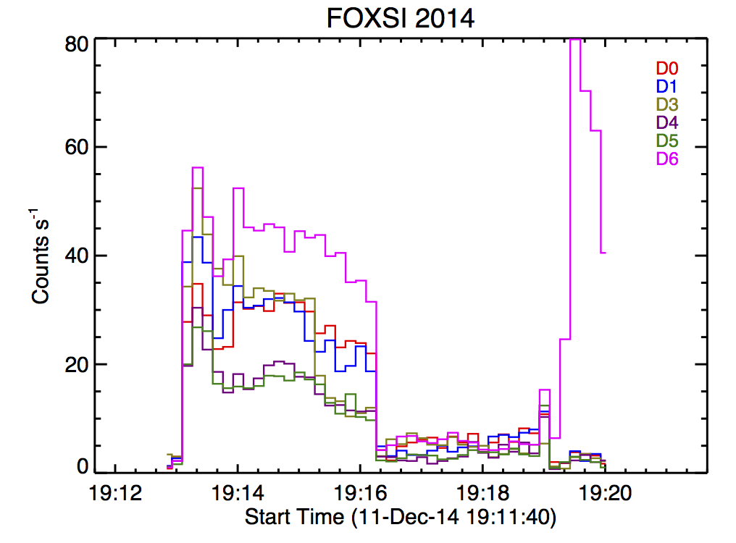
FOXSI time profile
Raw data; little/no processing done yet (no energy calibration).
D6 has greater area (3 more shells) and no attenuator.
Noise at shutter motion
AR1
AR2
AR3
QS
AR1

Slide 4
RHESSI time profile

Slide 5
FOXSI images, AR1

Slide 6
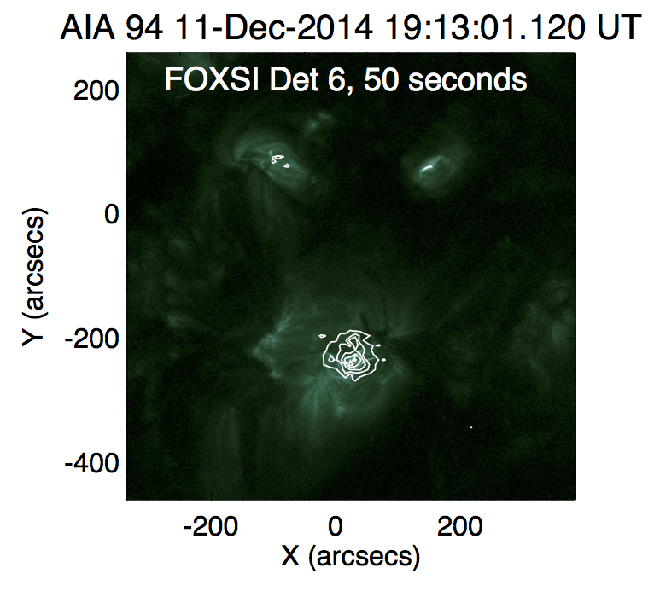
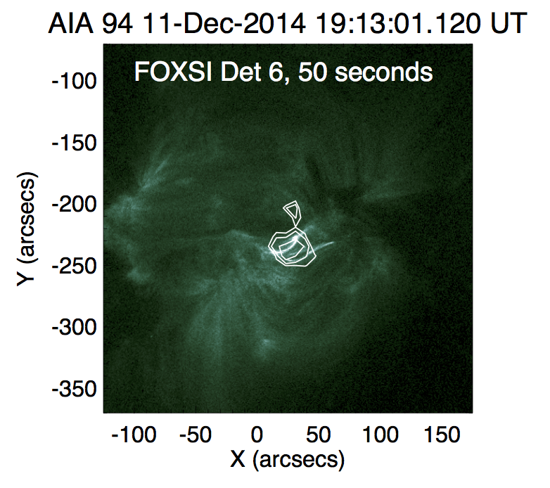
AR1, with AIA 94A
Sources are lined up by eye.
Note the angry monkey face.

Slide 7
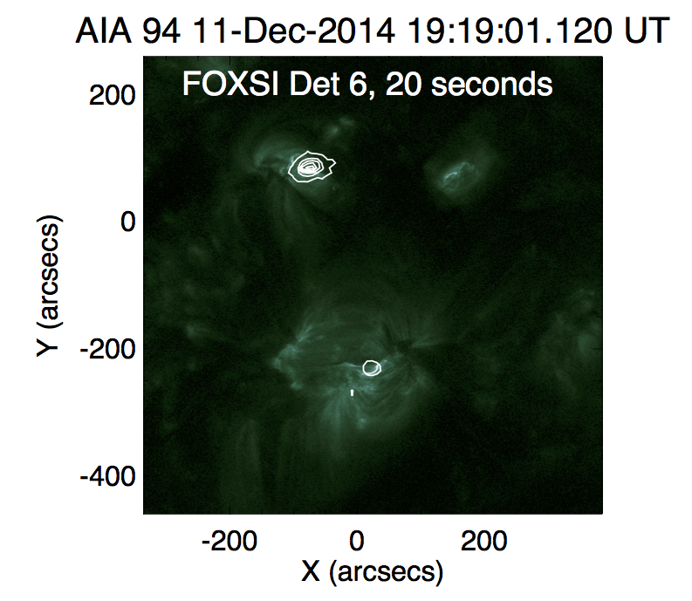
Last target, with AIA 94

Slide 8
Decaying limb flare and NuSTAR/FOXSI observations
NuSTAR

Slide 9
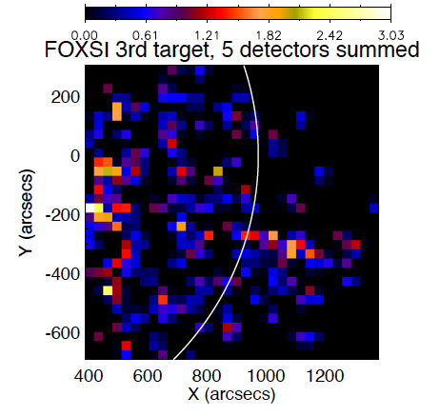
Does FOXSI also see it?
Hint of something at the limb, but not all detectors agree.
Flux on the disk? Maybe. (But be careful about ghost rays…)

